Slide 1
Coding-Advanced

Slide 2

Coding-Advanced
Coding Foundation - Summary
Writing code as per coding guidelines
Organizing the code sensibly
Abstract Data Types and Wrapper Functions
Tools for better programming
Editors
Debugger
Memory Analysis tools

Slide 3

Coding-Advanced
Coding Proficient - Summary
Writing code with zero errors
Cyclomatic complexity less than 10 for most of the code
Network level Portability
Debugging code through tracing / Debugging

Slide 4

Coding-Advanced
Coding
Who is a great developer ??
Notes:
Lets revisit this question.
Someone who codes as per design, to meet the requirements and creates a code which is highly maintainable and has no bugs. NO BUGS!

Slide 5
Coding-Advanced
Coding Advanced - Objectives
To be a better developer by being able to:
Writing perfect (error-free/warning-free) code
Reducing Cyclomatic Complexity
Code meeting Performance guidelines
Debugging/ramping up on unfamiliar code.
Notes:
Set the expectation that at this level you should be a developer with impeccable programming skills.
You may write lesser code than before, but whatever you write, or get people to write should be high class.
Flow
Discuss typical warnings. Do long assignment
Discuss cyclomatic complexity. Do assignment. We are reemphasizing on this by focusing on it on all 3 levels
Discuss peformance issues in code (compute bound). Do assignment/
If we have time, have one more hour long assignment.

Slide 6
Coding-Advanced
“Everyone knows that debugging is twice as hard as writing a program in the first place. So if you're as clever as you can be when you write it, how will you ever debug it?”
― Brian W. Kernighan
Here we go!

Slide 7

Coding-Advanced
Perfect Code!
Lets look at
Typical Warnings
Typical Bugs
Solutions!

Slide 8
Coding-Advanced
Common Bugs and Solutions
Categories
Data and Arithmetic Bugs
Memory and Pointer Related Bugs
Aliasing Related Bugs
Security Vulnerability Related Bugs

Slide 9
Coding-Advanced
Un-initialized local variables (Incorrect Code)
Identify the problem in this code snippet
#include<stdio.h>
int main()
{
int i,k;
for(i = 0;i < 9;i++)
{
k = k + 1;
}
printf("final value of k:%d\n",k);
return 0;
}
What warning would be given by “splint” for this piece of code?
How do you correct the same?
Here k is only declared and not initialized so we cannot be sure about it’s initial value. Whatever be the content of the memory location will be the initial value of k. This lead to UMR and also unpredictable output

Slide 10
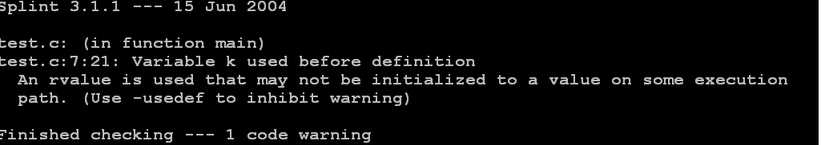
Coding-Advanced
Un-initialized local variables (Output with splint)

Slide 11
Coding-Advanced
Un-initialized local variables (Correct Code)
#include<stdio.h>
int main()
{
int i,k = 0;
for(i = 0;i < 9;i++)
{
k = k + 1;
}
printf("final value of k:%d\n",k);
return 0;
}
All local variables must be explicitly initialized before they are used

Slide 12
Coding-Advanced
Buffer Overflow (Incorrect Code)
Identify the problem in this code snippet
#include <stdio.h>
#include <stdlib.h>
#include <string.h>
#define MAX 5
int main()
{
char *str = NULL, name[MAX];
str = (char *)malloc(3 * sizeof(char));
printf("Please Enter a string\n");
scanf("%s", name);
strcpy(str,name);
free(str);
return 0;
}
What error would be given by “valgrind” for this piece of code?
How do you correct the same?
Here if the length of the array copied into str is larger than the memory allocated for str then this will results in ABW

Slide 13
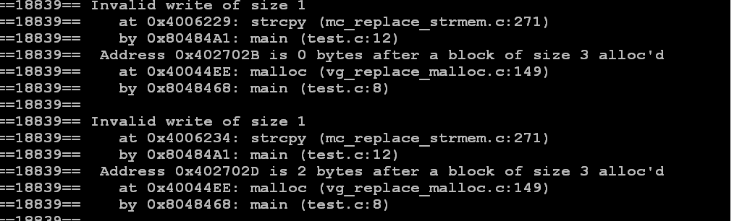
Coding-Advanced
Buffer Overflow (Output with valgrind)

Slide 14
Coding-Advanced
Buffer Overflow (Correct Code)
#include<stdio.h>
#include<stdlib.h>
#include<string.h>
#define MAX 5
#define SZ 3
int main()
{
int length;
char *str = NULL,name[MAX];
str = (char *)malloc(SZ * sizeof(char));
printf("Please enter a string\n");
scanf("%s", name);
length = strlen(name);
if( length > 0 && length < SZ )
{
strcpy(str,name);
}
free(str);
return 0;
}
Check for the boundary conditions before copying the string

Slide 15
Coding-Advanced
Off by one Error (Incorrect Code)
Identify the problem in this code snippet
Could you predict the output of this code snippet?
How do you correct the mistake?
#include <stdio.h>
#include <string.h>
#define MAX 10
int main()
{
char src[MAX],dest[MAX];
int x,len;
printf("Enter a string\n");
scanf("%s", src);
len = strlen(src);
for(x = 1; x < len; x++)
{
dest[x] = src[x];
printf("dest[%d]=%c\n", x, dest[x]);
}
dest[x] = ‘\0’;
printf("Dest string is:%s\n",dest);
return 0;
}
Here the loop starting from 1 instead of 0. Also ‘\0’ is not appended at the end.
Trying to access the base address of an array which is not initialized

Slide 16
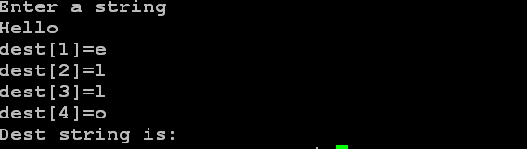
Coding-Advanced
Off by one Error (Output on execution)

Slide 17
Coding-Advanced
Off by one Error (Correct Code)
#include <stdio.h>
#include <string.h>
#define MAX 10
int main()
{
char src[MAX],dest[MAX];
int x,len;
printf("Enter a string\n");
scanf("%s", src);
len = strlen(src);
for(x = 0; x < len; x++)
{
dest[x] = src[x];
printf("dest[%d]=%c\n", x, dest[x]);
}
dest[x] = ‘\0’;
printf("Dest string is:%s\n",dest);
return 0;
}
Index must start from 0. Also ‘\0’must be appended at the end.

Slide 18
Coding-Advanced
Enumerated Data Types (Incorrect Code)
Identify the problem in this code snippet
#include <stdio.h>
typedef enum {A,B,C,D} grade ;
int main()
{
grade x;
char str[5] = "Test";
char l;
x = A;
l = str[x - 1];
printf("l is:%c\n",l);
return 0;
}
What error would be given by “valgrind” for this piece of code?
How do you correct the same?
Trying to access the -1 index of an array causing Buffer Underflow

Slide 19
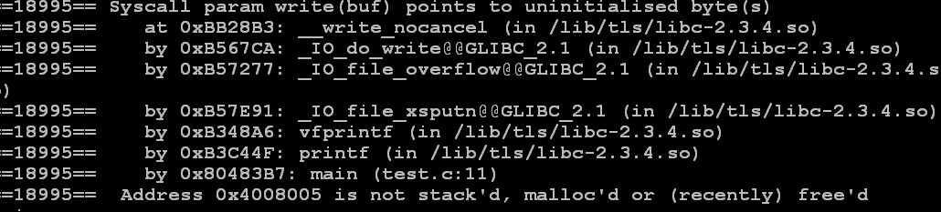
Coding-Advanced
Enumerated Data Types (Output with valgrind)

Slide 20
Coding-Advanced
Enumerated Data Types (Correct Code)
#include <stdio.h>
typedef enum {A = 1,B,C,D} grade ;
int main()
{
grade x;
char str[5] = "Test";
char l;
x = A;
l = str[x - 1];
printf("l is:%c\n",l);
return 0;
}
Values of enumerated data types must be carefully defined when used for indexing an array

Slide 21
Coding-Advanced
Wrong Assumptions on Operator Precedence (Incorrect Code)
Identify the problem in this code snippet
Could you predict the output of this code snippet?
How do you correct the mistake?
#include<stdio.h>
#define SQUARE(x) (x*x)
int main()
{
int value;
value = SQUARE(1 + 2);
printf("Square is :%d \n", value);
return 0;
}
When this macro gets executed we get unexpected value (* has higher precedence than +). Macro is going to be expanded as 1+2*1+2 instead of expected (1+2) * (1+2)

Slide 22
Coding-Advanced
Wrong Assumptions on Operator Precedence (Output)

Slide 23
Coding-Advanced
Wrong Assumptions on Operator Precedence (Correct Code)
#include<stdio.h>
#define SQUARE(x) ((x)*(x))
int main()
{
int value;
value = SQUARE(1 + 2);
printf("Square is :%d \n", value);
return 0;
}
All operands must be in parenthesis. Avoid using complicated expressions as macros

Slide 24
Coding-Advanced
Value outside the domain (Incorrect Code)
Identify the problem in this code snippet
#include<stdio.h>
int main()
{
int fact = 1;
int count,num;
printf("Enter a number:");
scanf("%d",&num);
for(count = 1;count <= num;count++)
{
fact = fact * count;
}
printf("factorial of %d is :%d \n",num,fact);
return 0;
}
Could you predict the output of this code snippet?
How do you correct the mistake?
Here fact can take values within the range of int. Values outside the domain would cause unwanted results

Slide 25
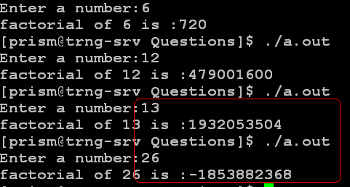
Coding-Advanced
Value outside the domain (Output)

Slide 26
Coding-Advanced
Values outside the Domain (Correct Code)
#include<stdio.h>
int main()
{
long long int fact=1;
int count,num;
printf("Enter a number:");
scanf("%d",&num);
for(count = 1;count <= num;count++)
{
fact = fact * count;
}
printf("factorial of %d is :%lld \n",num,fact);
return 0;
}
Be careful while defining variables. It should hold data large enough based on the application

Slide 27
Coding-Advanced
Undefined order of side effects (Incorrect Code)
Identify the problem in this code snippet
#include <stdio.h>
int main()
{
int num[5];
int i = 1;
int ii = i / ++i;
num[i++] = i++;
printf ("i /++i = %d\n, ",ii );
printf("num[i] = %d\n", num[i]);
return 0;
}
What warning would be given by “splint” for this piece of code?
How do you correct the same?
In a single expression itself, we may not surely guess the order of the side effects. i / i++ leads to undefined behavior because left operand is modified is by right operand. num[i++] = i++ leads to undefined behavior because left operand uses i which is modified by right operand.

Slide 28
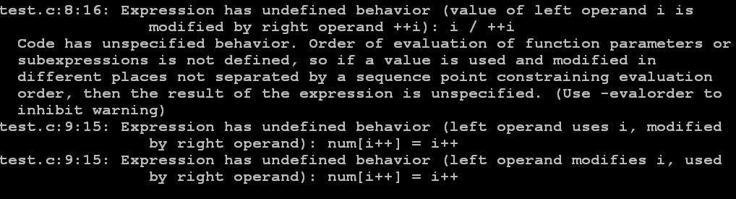
Coding-Advanced
Undefined order of side effects (Output with splint)

Slide 29
Coding-Advanced
Undefined order of side effects (Correct Code)
#include <stdio.h>
int main()
{
int num[5];
int i = 1;
int ii;
++i;
ii = i / i;
i++;
num[i] = i;
printf ("i /++i = %d\n, ",ii );
printf("num[i] = %d\n", num[i]);
return 0;
}
Better not to mix increment / decrement ++ / --) in expressions. They are prone to undefined behavior.

Slide 30
Coding-Advanced
Use of = instead of == (Incorrect Code)
Identify the problem in this code snippet
#include<stdio.h>
#define NUMBER 6
int main()
{
int x = 5;
if( x = NUMBER )
{
printf("If part gets executed \n");
}
else
{
printf("Else part gets executed \n");
}
return 0;
}
What warning would be given by “splint” for this piece of code?
How do you correct the same?
Using = for comparison always make the condition inside true, therefore the else part never gets executed. In this case compiler never gives error

Slide 31
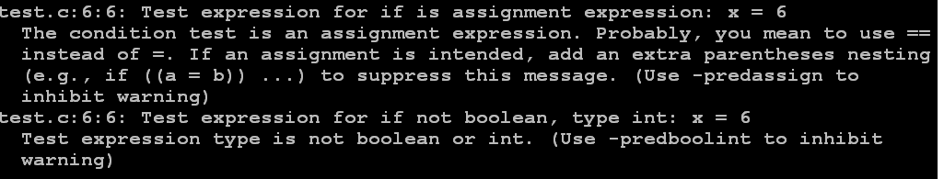
Coding-Advanced
Use of = instead of == (Output with splint)

Slide 32
Coding-Advanced
Use of = instead of == (Correct Code)
#include<stdio.h>
#define NUMBER 6
int main()
{
int x = 5;
if( NUMBER == x)
{
printf("If part gets executed \n");
}
else
{
printf("Else part gets executed \n");
}
return 0;
}
Good Practice is to keep constant on left side so that such unintentional errors can be captured by compiler itself

Slide 33
Coding-Advanced
Break missing in switch-case (Incorrect Code)
Identify the problem in this code snippet
What warning would be given by “splint” for this piece of code?
How do you correct the same?
#include<stdio.h>
int main()
{
int x = 2;
switch (x)
{
case 1:
printf("One\n");
case 2:
printf("two\n");
case 3:
printf("Three\n");
default:
printf("Default\n");
}
return 0;
}
break statement is missing in all cases causing the remaining cases to get execute. Such a scenario may executed the part of code not desired to be executed resulted into unwanted behavior (fall through statement)

Slide 34
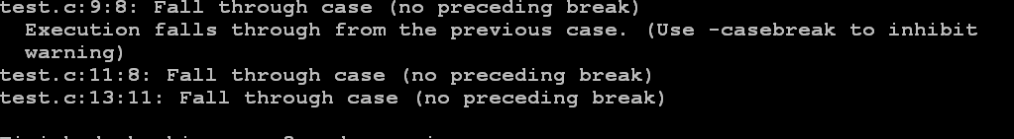
Coding-Advanced
Break missing in switch-case (Output with splint)

Slide 35
Coding-Advanced
Break missing in switch-case (Correct Code)
#include<stdio.h>
int main()
{
int x = 2;
switch (x)
{
case 1:
printf("One\n");
break;
case 2:
printf("two\n");
break;
default:
printf("Default\n");
break;
}
return 0;
}
Each case statement must end with break statement until unless there was an intent to transfer flow through a case statement to the next case statement

Slide 36
Coding-Advanced
Mismatch in the format and value to be printed in printf (Incorrect Code)
Identify the problem in this code snippet
What warning would be given by GCC (with –Wall option) for this piece of code?
How do you correct the same?
#include<stdio.h>
#include<limits.h>
int main()
{
/*For 32-bit machine ULONG_MAX is 4,294,967,295*/
unsigned long int ul = ULONG_MAX;
printf("value is:%d\n",ul);
return 0;
}
Here we are trying to print unsigned long integer value using wrong format specifier. In some cases this problem may lead to crash

Slide 37
Coding-Advanced
Mismatch in the format and value to be printed in printf (Output with gcc Wall option)

Slide 38
Coding-Advanced
Mismatch in the format and value to be printed in printf (Correct Code)
#include<stdio.h>
#include<limits.h>
int main()
{
/*For 32-bit machine ULONG_MAX is 4,294,967,295*/
unsigned long int ul = ULONG_MAX;
printf("value is:%lu\n",ul);
return 0;
}
Make sure format specifier matches the value to be printed

Slide 39
Coding-Advanced
Copy Paste Errors (Incorrect Code)
Identify the problem in this code snippet
#include<stdio.h>
#include<limits.h>
int main()
{
int x = INT_MAX; /*For 32-bit machine INT_MAX is 2,147,483,647 */
if(x + 100 < x)
{
printf("No overflow. Success!!\n");
x = x + 100;
return 1;
}
else
{
printf("Integer Overflow. Failure!!\n");
x = x + 100;
return 1;
}
}
Here intent was to check for Overflow condition and then only perform the operation. However copy-paste results into same code in else part thus results into overflow

Slide 40
Coding-Advanced
Copy Paste Errors (Correct Code)
#include<stdio.h>
#include<limits.h>
int main()
{
int x = INT_MAX; /*For 32-bit machine INT_MAX is 2,147,483,647 */
if(x + 100 < x)
{
printf("No overflow. Success!!\n");
x = x + 100;
return 1;
}
else
{
printf("Integer Overflow. Failure!!\n");
return 0;
}
}
Special care must be taken for ensuring that code must be appropriately changed

Slide 41
Coding-Advanced
Loop Errors (Incorrect Code)
Identify the problem in this code snippet
#include <stdio.h>
int main()
{
int x = 5;
while (x > 0);
{
printf( "Value of x :%d \n", x);
x--;
}
return 0;
}
What warning would be given by “splint” for this piece of code?
How do you correct the same?
Here semicolon after while will cause this loop to run infinitely hence the code after this will never gets executed

Slide 42
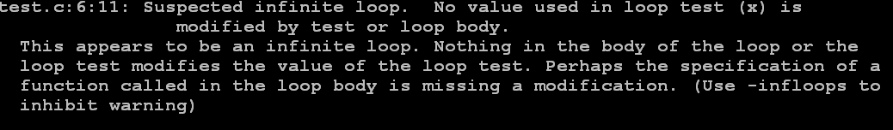
Coding-Advanced
Loop Errors (Output with splint)

Slide 43
Coding-Advanced
Loop Errors (Correct Code)
#include<stdio.h>
int main()
{
int x = 5;
while (x > 0)
{
printf( "Value of x :%d \n", x);
x--;
}
return 0;
}
Ensure that the loop conditions are checked properly

Slide 44
Coding-Advanced
Input/Output Errors (Incorrect Code)
Identify the problem in this code snippet
#include <stdio.h>
#include <stdlib.h>
#define MAX 20
int main()
{
FILE* infile;
char string[MAX];
infile = fopen("sample", "r");
while(!feof(infile))
{
fscanf(infile,"%s", string);
printf("%s\n", string);
}
fclose(infile);
return 0;
}
Here the problem is that the return value of fopen is not checked for. It could happen such a way that fopen fails and feof and fgets crah the program
Could you predict the oputput?
Here problem is that feof returns non-zero value if it detects EOF. So, after the last line is read in and printed out, feof() will still return 0 again and the loop will continue until fgets detects and set EOF.

Slide 45

CCoding-Advanced
Input/Output Errors (Output)
“Hi” is repeated twice even though there was only 1 “Hi” in the file. The last line is repeated.

Slide 46
Coding-Advanced
Input/Output Errors (Correct Code)
#include <stdio.h>
#include <stdlib.h>
#define MAX 20
int main()
{
FILE* infile;
char string[MAX];
infile = fopen("sample", "r");
if(NULL == infile)
{
printf("File can not be opened\n");
exit(EXIT_FAILURE);
}
while(1)
{
fscanf(infile,"%s", string);
if(feof(infile))
break;
printf("%s\n", string);
}
fclose(infile);
return 0;
}
Always check for the return value of fopen to find out whether it was successful or not
Before using all input/output function make sure what type of value all these functions returns

Slide 47
Coding-Advanced
String Handling Errors (Incorrect Code)
Identify the problem in this code snippet
#include<stdio.h>
#include<stdlib.h>
#include<string.h>
#define MAX 12
int main()
{
char src[MAX]="test_string";
char *dest;
dest = (char *)malloc(strlen(src));
strcpy(dest,src);
free(dest);
return 0;
}
What warning would be given by “splint” for this piece of code?
How do you correct the same?
Problem here is when allocating memory for dest string no room had been left for copying nul (‘\0’) at the end. This leads to ABW and can also corrupt heap.

Slide 48
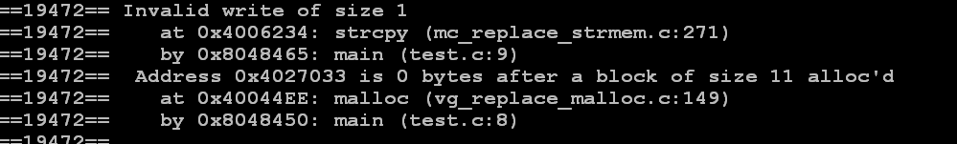
Coding-Advanced
String Handling Errors (Output with splint)

Slide 49
Coding-Advanced
String Handling Errors (Correct Code)
#include<stdio.h>
#include<stdlib.h>
#include<string.h>
#define MAX 12
int main()
{
char src[MAX]="test_string";
char *dest;
dest = (char *)malloc(strlen(src)+1);
strcpy(dest,src);
free(dest);
return 0;
}
Special care must be taken while dealing with strings. Always make sure memory allocated for strings contains extra space for nul (‘\0’)

Slide 50
Coding-Advanced
Un-initialized Memory (Incorrect Code)
Identify the problem in this code snippet
What warning would be given by “splint” for this piece of code?
How do you correct the same?
#include<stdio.h>
#include<string.h>
int main()
{
char *str;
strcpy(str, “PRISM”);
return 0;
}
str points to possible Invalid character array

Slide 51
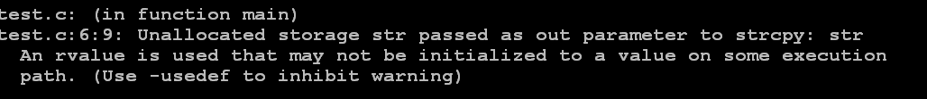
Coding-Advanced
Un-initialized Memory (Output with splint)

Slide 52
Coding-Advanced
Un-initialized Memory (Correct Code)
#include <stdio.h>
#include <stdlib.h>
#include <string.h>
#define MAX 10
int main()
{
char *str = NULL;
str =(char *)malloc(MAX * sizeof(char));
if(NULL == str)
{
printf("Malloc failure\n");
exit(0);
}
strcpy(str,"PRISM");
free(str);
return 0;
}
Now str points to the allocated array

Slide 53
Coding-Advanced
NULL pointer De-referencing (Incorrect Code)
Identify the problem in this code snippet
What warning would be given by “splint” for this piece of code?
How do you correct the same?
#include<stdio.h>
#include<string.h>
int main()
{
char *str;
strcpy(str, “PRISM”);
return 0;
}
str points to possible Invalid character array

Slide 54
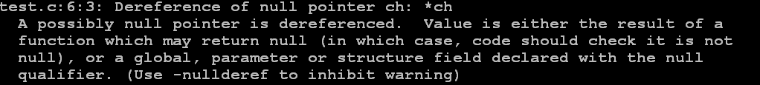
Coding-Advanced
NULL pointer De-referencing (Output with splint)

Slide 55
Coding-Advanced
NULL pointer De-referencing (Correct Code)
#include<stdio.h>
int main()
{
char *ch = NULL;
if(NULL != ch)
{
*ch = 'a';
}
return 0;
}
Whenever an object is being de-referenced, take care to see that it has been initialized in all possible paths to the point of dereferencing

Slide 56
Coding-Advanced
Free already freed pointer (Incorrect Code)
Identify the problem in this code snippet
#include <stdio.h>
#include <stdlib.h>
#define MAX 10
int main()
{
char *ch = NULL;
ch = (char *)malloc(MAX * sizeof(char));
/*Some statements*/
free(ch);
/*Some statements*/
free(ch);
return 0;
}
What warning would be given by “splint” for this piece of code?
How do you correct the same?
Trying to free already freed memory

Slide 57
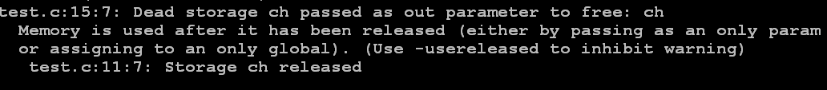
Coding-Advanced
Free already freed pointer (Output with splint)

Slide 58
Coding-Advanced
Free already freed pointer (Correct Code)
#include <stdio.h>
#include <stdlib.h>
#define MAX 10
int main()
{
char *ch = NULL;
ch = (char *)malloc(MAX * sizeof(char));
/*Some statements*/
free(ch);
ch = NULL;
/*Some statements*/
if(NULL != ch)
{
free(ch);
}
return 0;
}
It is a good practice to initialize the freed pointer to NULL

Slide 59
Coding-Advanced
Memory leak (Incorrect Code)
Identify the problem in this code snippet
#include<stdio.h>
#include<string.h>
#include<stdlib.h>
#define MAX 10
int main()
{
char *str = NULL;
str =(char *)malloc(MAX * sizeof(char));
if(NULL == str)
{
printf("Malloc failure\n");
exit(0);
}
strcpy(str,"PRISM");
printf(“%s\n”, str);
return 0;
}
What error would be given by “valgrind” for this piece of code?
How do you correct the same?
Here memory allocated for pointer “str” is not freed before the function returns

Slide 60
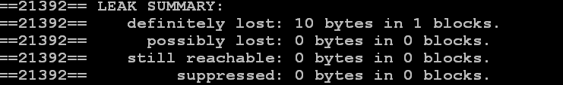
Coding-Advanced
Memory Leak (Output with valgrind)

Slide 61
Coding-Advanced
Memory leak (Correct Code)
#include<stdio.h>
#include<string.h>
#include<stdlib.h>
#define MAX 10
int main()
{
char *str = NULL;
str =(char *)malloc(MAX * sizeof(char));
if(NULL == str)
{
printf("Malloc failure\n");
exit(0);
}
strcpy(str,"PRISM");
printf(“%s\n”, str);
free(str);
return 0;
}
Memory allocated for a pointer must be subsequently freed so as to make the application runs without halting

Slide 62
Coding-Advanced
Temporary Values Returned (Incorrect Code)
Identify the problem in this code snippet
#include<stdio.h>
static int *func(void);
int main()
{
int num,*ptr = NULL;
ptr = (int *)func();
num = *ptr;
return 1;
}
int *func()
{
int num1;
num1 = 10;
return(&num1);
}
Caller attempts to use the variable, this result in a BSR (Beyond Stack Read) and can lead to corruption or crash
What would be warning from compiler (GCC)?
Here function returning a pointer to a local variable that has gone out of scope after the function returns. On compilation compiler gives warning

Slide 63
Coding-Advanced
Temporary Values Returned (warning from gcc)

Slide 64
Coding-Advanced
Temporary Values Returned (Correct Code)
#include<stdio.h>
#include<stdlib.h>
static int *func(void);
int main()
{
int num,*ptr = NULL;
ptr = (int *)func();
if(NULL != ptr)
{
num = *ptr;
}
free(ptr);
return 0;
}
int *func()
{
int *num1 = NULL;
num1 = (int *) malloc(sizeof(int));
if(NULL == num1)
{
return NULL;
}
*num1 = 10;
return(num1);
}
Memory allocated on the heap remains allocated until it is explicitly freed. So, best way is to allocate some memory, put value's in it and return completely valid pointer to that address

Slide 65
Coding-Advanced
Need of Unique Address (Incorrect Code)
Identify the problem in this code snippet
#include<stdio.h>
#include<stdlib.h>
int main()
{
int *ptr1 = NULL,*ptr2 = NULL;
ptr1 =(int*)malloc(sizeof(int));
if(ptr1 != NULL)
{
*ptr1 = 10;
}
ptr2 = ptr1;
free(ptr1);
ptr1 = NULL;
*ptr2 = 8;
return 0;
}
What warning would be given by “splint” for this piece of code?
How do you correct the same?
Here both ptr1 and ptr2 points to same memory locations. Freeing ptr1 freed that memory location and ptr2 becomes dangling pointer. Writing to that memory location results in FMW and may even lead to crash

Slide 66
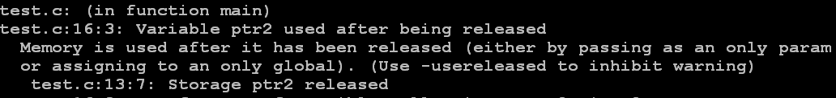
Coding-Advanced
Need of Unique Address (Output with splint)

Slide 67
Coding-Advanced
Need of Unique Address (Correct Code)
#include<stdio.h>
#include<stdlib.h>
int main()
{
int *ptr1 = NULL,*ptr2 = NULL;
ptr1 =(int*)malloc(sizeof(int));
if(ptr1 != NULL)
{
*ptr1 = 10;
}
ptr2 = ptr1;
free(ptr1);
ptr1 = ptr2 = NULL;
if(NULL != ptr2)
{
*ptr2 = 8;
}
return 0;
}
If pointer aliases is used then make sure when one pointer is freed all its aliases also must be set to NULL

Slide 68
Coding-Advanced
Stack Overflow (Incorrect Code)
Identify the problem in this code snippet
#include<stdio.h>
#include<string.h>
#define SZ1 10
#define SZ2 20
static void func(char *);
int main()
{
char large_string[SZ2];
int i;
for( i = 0; i < SZ2-1; i++)
{
large_string[i] = 'A';
}
large_string[SZ2-1] = ‘\0’;
func(large_string);
return 0;
}
void func(char *str)
{
char buffer[SZ1];
strcpy(buffer,str);
}
What error would be given by “valgrind” for this piece of code?
How do you correct the same?
Here the data copied into buffer is larger than it can hold results in overflow. By means of such overflow malicious code is made to execute if the return address of the func is replaced by the address where malicious code is present

Slide 69
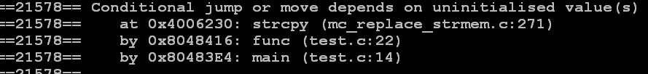
Coding-Advanced
Stack Overflow (Output with valgrind)

Slide 70
Coding-Advanced
Stack Overflow (Correct Code)
#include<stdio.h>
#include<string.h>
#define SZ1 10
#define SZ2 20
static void func(char *);
int main()
{
char large_string[SZ2];
int i;
for( i = 0; i < SZ2 - 1; i++)
{
large_string[i] = 'A';
}
large_string[SZ2-1] = '\0';
func(large_string);
return 0;
}
void func(char *str)
{
char buffer[SZ1];
int len;
memset(buffer,0,SZ1);
len = strlen(str);
if(len > 0 && len <= SZ1)
{
strcpy(buffer,str);
}
}
A good practice to prevent this error is by checking the ranges of the indices before copying the data into buffers

Slide 71
Coding-Advanced
Heap Overflow (Incorrect Code)
Identify the problem in this code snippet
#include <stdio.h>
#include <string.h>
#include <stdlib.h>
# define BUFSIZE 16
# define OVERSIZE 8
int main ()
{
unsigned long diff ;
char *buf1 = (char*)malloc(BUFSIZE*sizeof(char));
char *buf2 = (char*)malloc(BUFSIZE*sizeof(char));
diff = ( unsigned long ) buf2 - (unsigned long ) buf1 ;
printf ("buf1 = %p, buf2 = %p, diff = 0x%x bytes \n", buf1 , buf2 ,diff );
memset (buf2 , 'A' ,BUFSIZE - 1) ;
buf2 [ BUFSIZE -1] = '\0';
printf (" before overflow : buf2 = %s\n", buf2 );
memset (buf1 , 'B', ( unsigned int )( diff + OVERSIZE));
printf (" after overflow : buf2 = %s\n", buf2 );
free(buf1);
free(buf2);
return 0;
}
buf1 overruns its boundaries into buf2’s heap space causes heap overflow which can be used to execute some malicious code and do some illegal operations.
What error would be given by “valgrind” for this piece of code?
How do you correct the same?

Slide 72
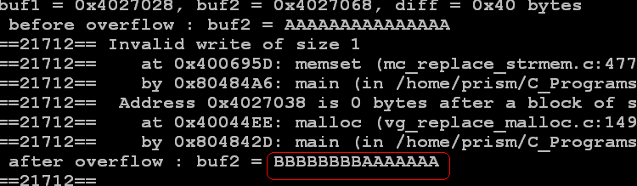
Coding-Advanced
Heap Overflow (Output with valgrind)

Slide 73
Coding-Advanced
Heap Overflow (Correct Code)
#include <stdio.h>
#include <string.h>
#include <stdlib.h>
# define BUFSIZE 16
# define OVERSIZE 8 /* overflow buf2 by OVERSIZE bytes */
int main ()
{
unsigned long diff ;
char *buf1 = (char*)malloc(BUFSIZE*sizeof(char));
char *buf2 = (char*)malloc(BUFSIZE*sizeof(char));
diff = ( unsigned long ) buf2 - (unsigned long ) buf1 ;
printf ("buf1 = %p, buf2 = %p, diff = 0x%x bytes \n", buf1 , buf2 ,diff );
memset (buf2 , 'A' ,BUFSIZE - 1) ;
buf2 [ BUFSIZE -1] = '\0';
printf (" before overflow : buf2 = %s\n", buf2 );
memset (buf1 , 'B', ( unsigned int )( BUFSIZE - 1));
printf (" after overflow : buf2 = %s\n", buf2 );
free(buf1);
free(buf2);
return 0;
}
Always make sure that bytes copied into the buffer is same as the memory allocated.

Slide 74
Coding-Advanced
Exposure of private data to un-trusted components
Identify the problem in this code snippet
#include <stdio.h>
#include <stdlib.h>
struct node
{
char *ch;
};
char * foo(struct node nn)
{
return (nn.ch );
}
int main ()
{
struct node n; char *ff;
n.ch =(char *) malloc(sizeof(char));
*(n.ch ) = 'A';
ff = foo(n);
*ff = 'B';
printf("%c\n", *(n.ch));
return 0;
}
Here ff has an access to structure variable. Sometimes it is most important to preserve the integrity and security of data. The data which is supposed to be private should not be given access to external sources.

Slide 75
Coding-Advanced
Cyclomatic Complexity - Impact
A higher Cyclomatic Complexity score means
lot of code paths and/or factors that affect the logic with the code
More difficult a piece of code is to read and understand
More difficult to test, and therefore, riskier to modify and maintain over time
Notes:
Reemphasize on impact of complexity:
If the complexity of a function is about 10, then at least 10 tests will have to be written only to fulfill the branch coverage, not counting other tests such as testing behavior for different values.

Slide 76
Coding-Advanced
Factors
Factors that increase complexity
Big Functions
Large loops
Nested conditionals
Validation across large structures
Notes:
Discuss the factors that increases CCN (Cyclomatic Complexity number)
Areas that increases complexity
Large loops
Nested conditionals
Validation across large structures

Slide 77
Coding-Advanced
Solution
Solution | Decomposition | Bool Algebra | Redesign | Thorough Testing
Pros | Fast & Easy | Fast & Reduces the C.C. | The only mean to reduce C.C. efficiently | No need to redesign the source code
Cons | Does not reduce C.C. | Not always applicable | Long & Rewrite tests | Hard to maintain
Notes:
Suggested solutions!
Decomposition: Extract code from large functions to make the function small and simple
Bool Algebra: The below code can be replaced with “if(A &&!B) || !A = mySimpleStatement”
if (A) {
if (!B) {
mySimpleStatement
}
} else {
mySimpleStatement
}
Redesign: Change of design (refactoring)
Thorough testing: Code remains as it is, but tested completely

Slide 78

Coding-Advanced
Performance
What are the performance bottlenecks?
How you measure them?

Slide 79

Coding-Advanced
Pre-Requisite
Go for optimization if any of these statements are not true:
parts of the program haven't been written yet
the program is not fully tested and debugged
it seems to run fast enough already

Slide 80

Coding-Advanced
Tips
Use the time(1) command to see if your program is
compute-bound,
memory bound,
I/O bound
Notes:
http://icps.u-strasbg.fr/~bastoul/local_copies/lee.html
http://www.azillionmonkeys.com/qed/optimize.html
Would discuss only compute-bound because other two are more design oriented

Slide 81

Coding-Advanced
Performance – Compute Bound
Write clear, simple code
Clear and readable code to compilers
Modularity
Clean and portable code

Slide 82

Coding-Advanced
Performance – Compute Bound
Perspective
Get a sense of how long certain operations take
A sure sign of misunderstanding is this fragment:
if (x != 0) x = 0;
The intent is to save time by not initializing x if it's already zero. In reality, the test to see whether it's zero or not will take up about as much time as setting it to zero itself would have.
x = 0;
has the same effect and will be somewhat faster.
Notes:
Among the slowest are opening a file, reading or writing significant amounts of data, starting a new process, searching, sorting, operations on entire arrays, and copying large amounts of data around.
The fastest operations are basic elements of the language like assigning to a variable, dereferencing a pointer, or adding two integers.

Slide 83
Coding-Advanced
Performance – Compute Bound
In-lining
gcc (with the -finline-functions option) and a few other compilers are capable of inlining small functions at higher optimization levels automatically.
If necessary, C functions can be recoded as macros to obtain similar speedup on compilers with no inlining capability
int foo(a, b)
{
a = a - b;
b++;
a = a * b;
return a;
}
#define foo(a, b) (((a)-(b)) * ((b)+1))
Notes:
Some caveats:
1. Gratuitously making every function in sight into a macro leads to massive code-bloat and can increase the amount of memory your program needs dramatically. The larger a program is, the less likely it is to fit entirely into cache or some other layer of physical memory, undoing the hoped for gains.
2. Macros in C "evaluate" their arguments each time the argument is mentioned inside the macro. If the actual argument passed to the macro is a complicated expression or function call, the net result very well may be an increase in CPU time. Performing multiple side-effects when the caller did not expect that will almost certainly make the program buggy.
3. Because these macros can contain complicated statements, optimizers have a hard time figuring them out and may give up. Also don't forget that there's a limit on how many characters a macro can have.
4. Profilers don't see macros so it's hard to optimize any further once you've done this.

Slide 84
Coding-Advanced
Performance – Compute Bound
for (i = 0; i < 100; i++)
{
do_stuff(i);
}
Loop unrolling
Many compilers (e.g. gcc -funroll-loops) will do this, but if you know that yours doesn't you can change your source code a bit to get the same effect.
for (i = 0; i < 100; )
{
do_stuff(i); i++;
do_stuff(i); i++;
do_stuff(i); i++;
do_stuff(i); i++;
do_stuff(i); i++;
do_stuff(i); i++;
do_stuff(i); i++;
do_stuff(i); i++;
do_stuff(i); i++;
do_stuff(i); i++;
}
Notes:
This way the test for i < 100 and the branch back up to the top of the loop only get executed 11 times rather than 101. Loop unrolling works best when the loop is executed a fixed non-prime number of times and the iteration variable is only modified in one place (aside from its initialization). If do_stuff() didn't make use of i, all the little i++'s could be replaced by a single i += 10. Re-arranging the for loop into a do-while loop can make the 11 into 10. If the loop only went to, say, five rather than 100 you could unroll the loop completely and eliminate the branching and testing entirely.
An unrolled loop is larger than the "rolled" version and so may no longer fit into the instruction cache (on machines which have them). This will make the unrolled version slower. Also, in this example, the call to do_stuff() overshadows the cost of the loop, so any savings from loop unrolling are insignificant in comparison to what you'd achieve from inlining in this case.

Slide 85
Coding-Advanced
Performance – Compute Bound
Loop jamming
The idea is to combine adjacent loops which loop over the same range of the same variable.
for (i = 0; i < MAX; i++) /* initialize 2d array to 0's */
for (j = 0; j < MAX; j++)
a[i][j] = 0.0;
for (i = 0; i < MAX; i++) /* put 1's along the diagonal */
a[i][i] = 1.0;
for (i = 0; i < MAX; i++)
{
for (j = 0; j < MAX; j++)
a[i][j] = 0.0; /* initialize 2d array to 0's */
a[i][i] = 1.0; /* put 1's along the diagonal */
}
Notes:
Assuming nothing in the second loop indexes forward (for example array[i+3])
And now the incrementing and testing of i is done only half as often. Under some circumstances, locality of reference may be better, improving cache behavior.

Slide 86
Coding-Advanced
Performance – Compute Bound
Strength Reduction
Strength reduction is the replacement of an expression by a different expression that yields the same value but is cheaper to compute.
x = w % 8;
y = pow(x, 2.0);
z = y * 33;
for (i = 0; i < MAX; i++)
{
h = 14 * i;
printf("%d", h);
}
x = w & 7; /* bit-and cheaper than remainder */
y = x * x; /* mult is cheaper than power-of */
z = (y << 5) + y; /* shift & add cheaper than mult */
for (i = h = 0; i < MAX; i++)
{
printf("%d", h);
h += 14; /* addition cheaper than mult */
}
Notes:
Many compilers will do this for you automatically.
Also note that array indexing in C is basically a multiply and an add. The multiply part can be subjected to strength reduction under some circumstances, notably when looping through an array.

Slide 87
Coding-Advanced
Performance – Compute Bound
Loop invariant Computations
Any part of a computation that does not depend on the loop variable and which is not subject to side effects can be moved out of the loop entirely.
A common but not-always-optimized-away case is the repeated use of an expression in successive statements.
total =
a->b->c[4]->aardvark +
a->b->c[4]->baboon +
a->b->c[4]->cheetah +
a->b->c[4]->dog;
struct animals * temp = a->b->c[4];
total =
temp->aardvark +
temp->baboon +
temp->cheetah +
temp->dog;
Notes:
Most compilers are pretty good at doing this. Try to keep the computations within the loop simple anyway, and be prepared to move invariant computations out yourself: there may be some situations where you know the value won't vary, but the compiler is playing it safe in case of side-effects. "Computation" here doesn't mean just arithmetic; array indexing, pointer dereferencing, and calls to pure functions are all possible candidates for moving out of the loop.
In loops which call other functions, you might be able to get some speedup by ripping the subroutines apart and figuring out which parts of them are loop-invariant for that particular loop in their caller and calling those parts ahead of time

Slide 88

Coding-Advanced
Performance – Compute Bound
Code for Common case
In a section of code which deals with several alternative situations, place at the beginning the tests and the code for the situations which occur most often.
Notes:
Frequently, this takes the form of a long train of mutually exclusive if-then-else's, of which only one will get executed. By placing the most likely one first, fewer if's will need to be performed over the long term.
But if the conditions are simple things like x == 3, consider using a switch statement. Some compilers are quite sophisticated in how they translate switch statements.

Slide 89

Coding-Advanced
Performance – Compute Bound
Variables
Avoid referring to global or static variables inside the tightest loops.
Don't use the volatile qualifier unless you really mean it.
Avoid passing addresses of your variables to other functions
Notes:
Most compilers take "volatile" to mean roughly the opposite of "register", and will deliberately not optimize expressions involving the volatile variable.
The optimizer has to assume that the called function is capable of stashing a pointer to this variable somewhere and so the variable could get modified as a side effect of calling what seems like a totally unrelated function. At less intense levels of optimization, the optimizer may even assume that a signal handler could modify the variable at any time. These cases interfere with placing variables in registers, which is very important to optimization.

Slide 90
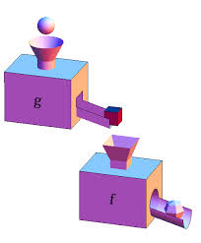
Coding-Advanced
Performance – Compute Bound
Function Calls
While functions and modularity are a good thing, a function call inside an oft-executed loop is a possible bottleneck
Notes:
Function calls interrupt an optimizer's train of thought in a drastic way. Any references through pointers or to global variables are now "dirty" and need to be saved/restored across the function call. Local variables which have had their address taken and passed outside the function are also now dirty, as noted above.
2. There is some overhead to the function call itself as the stack must be manipulated and the program counter altered by whatever mechanism the CPU uses.
3. If the function being called happens to be paged out, there will be a very long delay before it gets read back in. For functions called in a loop it's unusual for the called function to be paged out until the loop is finished, but if virtual memory is scarce, calls to other functions in the same loop may demand the space and force the other function out, leading to thrashing. Most linkers respect the order in which you list object files, so you can try to get functions near each other in hopes that they'll land on the same page.

Slide 91

Coding-Advanced
Performance – Compute Bound
String Operations
Most of the C library str* and mem* functions operate in time proportional to the length(s) of the string(s) they are given.
strlen
Avoid calling strlen() during a loop involving the string itself. Even if you're modifying the string, it should be possible to rewrite it so that you set x = strlen() before the loop and then x++ or x-- when you add or remove a character.

Slide 92

Coding-Advanced
Performance – Compute Bound
strcat
When building up a large string in memory using strcat, it will scan the full (current) length of the string on each call. If you've been keeping track of the length anyway you can index directly to the end of the string and strcpy or memcpy to there.

Slide 93
Coding-Advanced
Performance – Compute Bound
strcmp
You can save a little time by checking the first characters of the strings in question before doing the call. Obviously, if the first characters differ, there's no reason to call strcmp to check the rest.
#define QUICKIE_STRCMP(a, b) (*(a) != *(b) ? \
(int) ((unsigned char) *(a) - \
(unsigned char) *(b)) : \
strcmp((a), (b)))
Notes:
Watch out:
There's a double evaluation going on, so this can be counter-productive if the arguments to strcmp aren't just simple variables.
If you're working on adjacent strings in sorted input, you will almost always have to check past the first character anyway.

Slide 94

Coding-Advanced
Performance – Compute Bound
Stack Usage
A typical cause of stack-related problems is having large arrays as local variables. In that case the solution is to rewrite the code so it can use a static or global array, or perhaps allocate it from the heap.
A similar solution applies to functions which have large structs as locals or parameters.
Recursive functions, even ones which have few and small local variables and parameters, can still affect performance

Slide 95
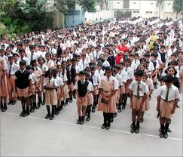
Coding-Advanced
Performance – Compute Bound
Code it in Assembly
A competent human writing assembly-level code can produce code which runs about 10% faster than what a compiler with full optimization on would produce from well-written high-level source.
Notes:
Estimates vary widely!

Slide 96

Coding-Advanced
Performance – Compute Bound
Shared Library overhead
Dynamically linked shared libraries are a really nifty thing.
In many cases though, calling a dynamically linked function is slightly slower than it would be to call it statically.
Notes:
The principal part of this extra cost is a one-time thing: the first time a dynamically called function is called there is a bit of searching going on, but thereafter the overhead should be a very tiny number of instructions.
For applications with thousands of functions, there can be a noticeable lag at startup. Linking statically will reduce this, but defeats (to some extent) the benefits of code sharing that dynamic libraries can bring. Often, you can selectively link some libraries as dynamic and others as static.

Slide 97

Coding-Advanced
Troubleshooting
What is the most effective way to add functionality to unfamiliar code?
Write from scratch
Use cowboy coding approach
Start by refactoring the initial code
Notes:
1. Write from scratch. It may work for small applications, but you can't use it for large codebase.
Note that for small to medium-size codebase, it's not the worst scenario to avoid at all costs.
There is a good reason to not rewriting from scratch: an old codebase is generally expected to be tested, to contain tricks which make the code working in some circumstances, etc., and when rewriting everything, you will introduce a bunch of bugs which were already solved.
This is an invalid argument in cases you're talking about, since you mentioned that the code has a very low quality: not tested, with missing specifications, never refactored, etc. Don't rewrite from scratch rule, on the other hand, must be limited to the high quality, QA-tested code.
2. Use cowboy coding approach: change everything, then test. This may fail or succeed depending mostly on the context.
Example 1: you are modifying the business-critical application. You know that your customer would be angry if you break something in existent code, and this customer is convinced that the actual product not only works well, but is also correctly written (or the customer just doesn't understand what is crappy spaghetti code vs. well-written code).
Here, you can't use cowboy coding, since you must not introduce new bugs. This means that you need to use one of two other approaches.
Example 2: your customer tells you that his experience with the previous developer was a disaster. The product doesn't even work half of the time, and is totally unusable as is. The customer understands that modifying the source code so badly written can introduce even more bugs.
Here, on the other hand, cowboy coding can be a good solution, if you're sure that it will reduce the overall cost, compared to two other solutions.
3. Start by refactoring the initial code, adding unit tests (and other testing required in specific cases), documenting it, etc., then add your modifications. This may be a good approach when the code is not too crappy and has some value. For example, if I know that the code was written by my more skilled colleague under time pressure and low budget constraints, I'll certainly use this approach since:
There are parts of code which are cleverly done,
You'll learn lots of things from the code you refactor.
Even under time pressure and low budget constraints, a code by a better skilled developer is still a code of certain level. It means that if there is a trick to make the application work in some circumstances, the skilled developer will still leave you a comment explaining why the following line of code was added.
I don't think there is one perfect solution: compare all three for each project or task, asset their respective cost, and select the best one depending on the circumstances. In general, follow two rules:
Rule 1: the better skilled are the developers who wrote the code, the more refactoring vs. rewriting from scratch you must use.
Rule 2: the larger is the project, the more refactoring vs. rewriting from scratch you must use.
Refactor a large database written by somebody more skilled than you. Rewrite from scratch small pieces of code or code written by unskilled programmers

Slide 98
Coding-Advanced
References
http://tocea.com/blog/2012/05/01/software-quality-metric-meanings-cyclomatic-complexity/
http://en.wikipedia.org/wiki/Performance_tuning
http://www.azillionmonkeys.com/qed/optimize.html
http://icps.u-strasbg.fr/~bastoul/local_copies/lee.html
http://en.wikipedia.org/wiki/Troubleshooting
http://programmers.stackexchange.com/questions/6395/how-do-you-dive-into-large-code-bases
http://programmers.stackexchange.com/questions/155488/ive-inherited-200k-lines-of-spaghetti-code-what-now

Slide 99
Disclaimer
Disclaimer
Aricent Group makes no representations or warranties with respect to contents of these slides and the same are being provided “as is”. The content/materials in the slides are of a general nature and are not intended to address the specific circumstances of any particular individual or entity. The material may provide links to internet sites (for the convenience of users) over which Aricent Group has no control and for which Aricent Group assumes no responsibility for the availability or content of these external sites. While the attempt has been to acknowledge sources of materials wherever traceable to an individual or an institution; any materials not specifically acknowledged is purely unintentional

Slide 100
Revision History
Revision History
Version No | Date of Release | Author | Approved by | Changes
0.1 | 22nd Jan 2014 | Sibu |  | Initial Draft

